Slide 1
Finding DX {Through DX SPOTS} Phil Gould, G4FVZ

Slide 2
What’s DX?
Acronym for long distance communication
Non-G contacts
Exotics
DXCC’s you haven’t got
Its really all relative – I’d like GI on 13cm!

Slide 3
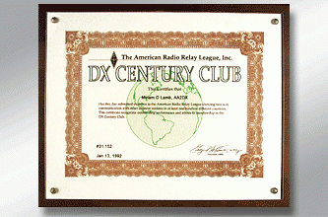
What’s DXCC
DX Century Club Award – 100 confirmed entities
Proof of contact – LoTW
5-Band DXCC
By mode
DXCC Country List - 338 Places

Slide 4
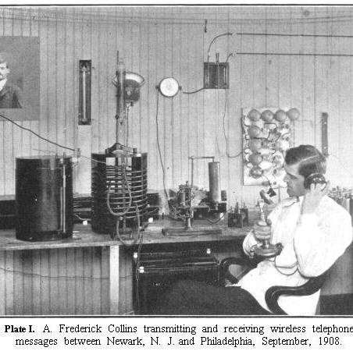
If You Love Just tuning The Bands – Go Ahead
This is all about sharpening your game

Slide 5
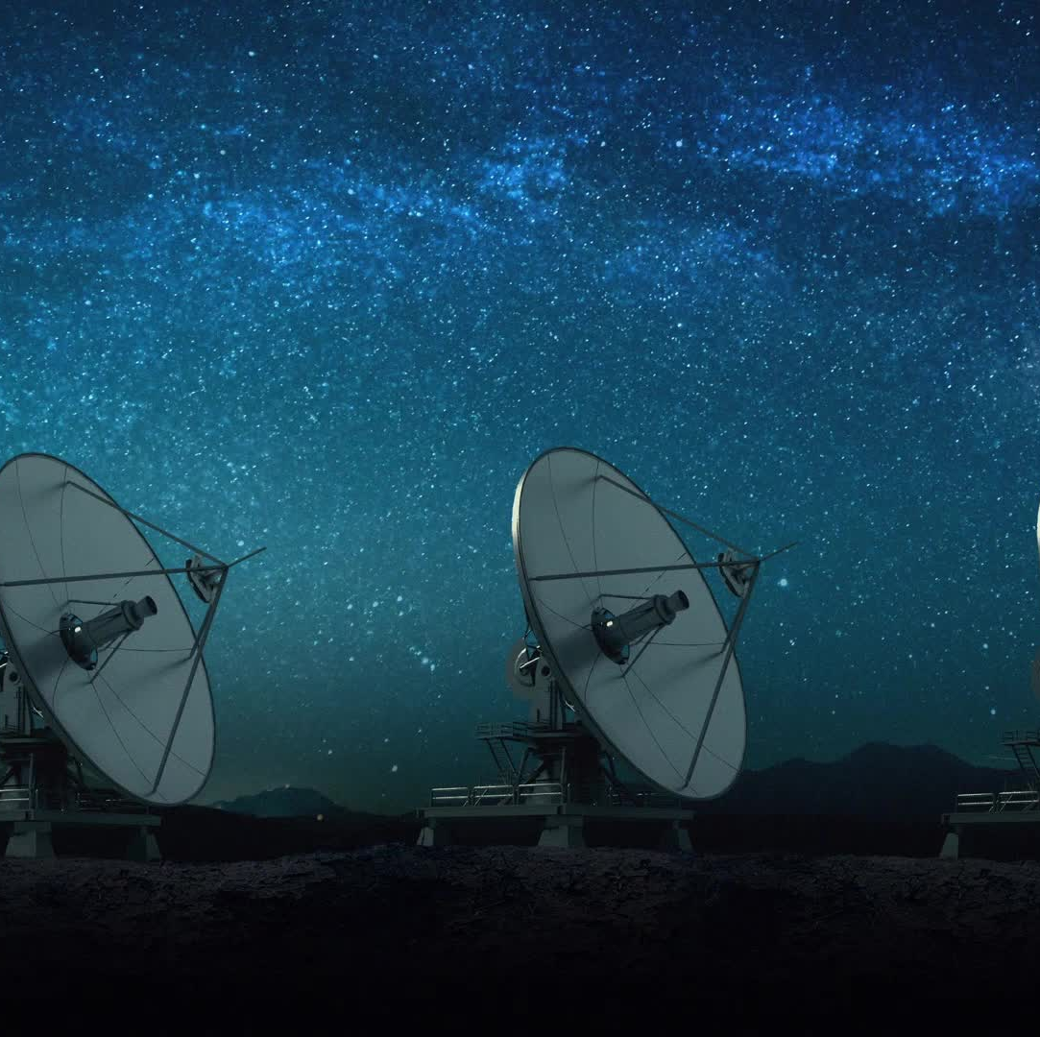
Before You Start – Things To Consider
HF
Propagation
Time of day/year – summer doldrums, grey-line
Antennas – direction, angle of radiation
Know where your new DXCC is
Decide what you are hunting with – QRP or QRO
Exploit contests – CQ WW
VHF
Tropo, E’s, meteors, rain, aurora

Slide 6
So What’s a Spot?
Something that helps you find the DX – someone has ‘spotted’ it
Usually delivered by a ‘Cluster’
Can be ‘Passive’ and ‘Active’

Slide 7
Before You chase Spots Do the Simple Things
CAT control with station logger – highly desirable
QRG, mode, beam heading
Use what the logger already provides
Remember contests - Call last, Call late
Have CW and QRO available
Major DX Expeditions on FT8
Persist

Slide 8
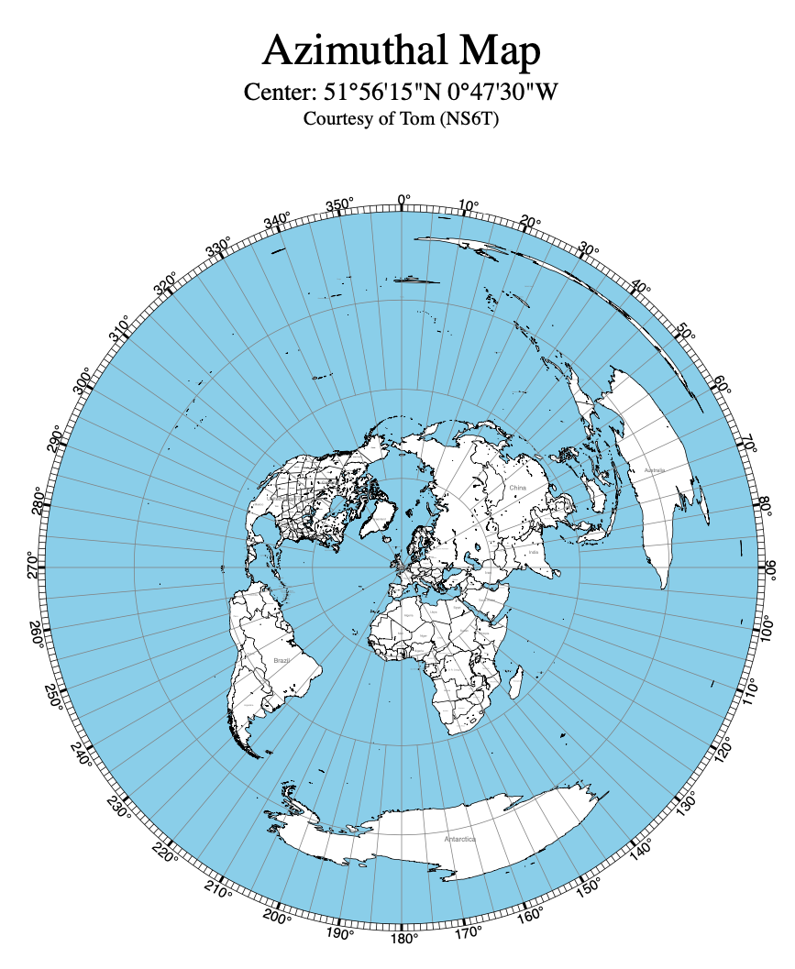
Know which way you are pointing to hunt

Slide 9
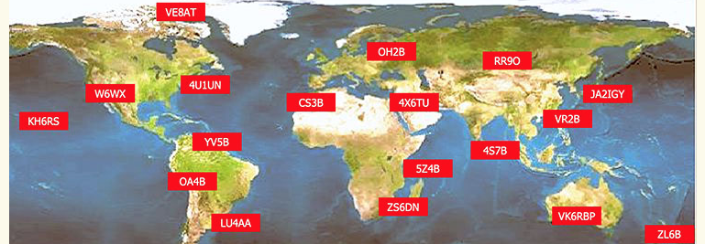
Check Out Beacons
Look up timing and frequency
For 10m and 6m use Beaconspot

Slide 10
Let’s Get Going : Probe Band (and your Set Up) with Passive Tools
Internet scrapers
Reverse Beacon Network (RBN)
PSK Reporter
Don’t forget to spot yourself

Slide 11
Take A Look At Propagation Predictors

Slide 12
Reverse Beacon Network (RBN)

Slide 13
PSK Reporter : Data Modes

Slide 14
A Lot of DX is on Digital: Understand and Use FT8 Fox & Hounds Mode
Special Operating Mode For FT8 – Dxpeditions
Identify the Fox – must use ‘split’
They may have a spot QRG low down (300-900Hz)
You are the Hound – transmit above 1000Hz
You must ‘see’ the Fox
Allows DX station to work up to 5 people at once
Remember to switch it off after!

Slide 15
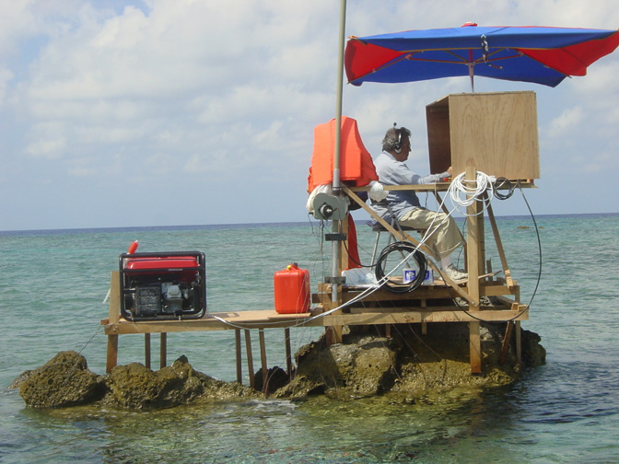
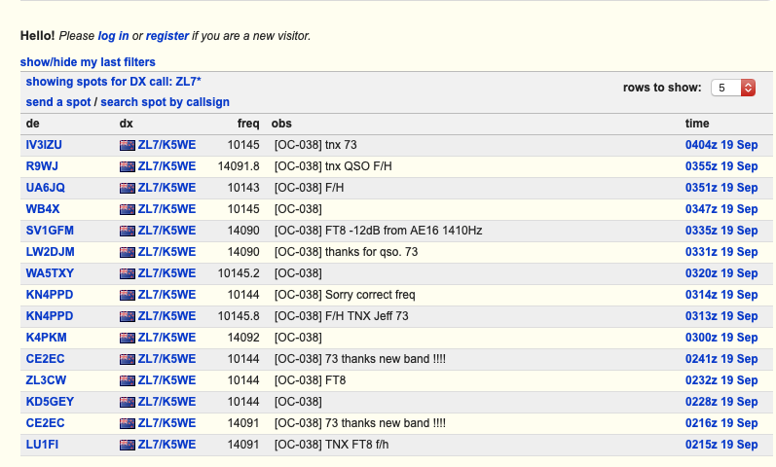
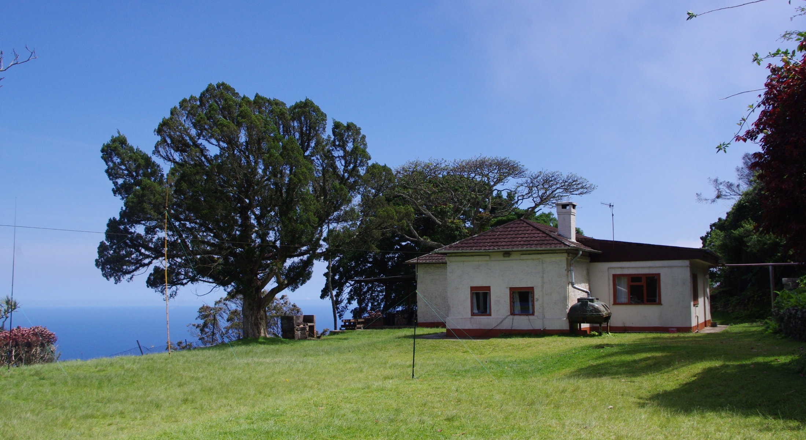
Chasing Dxpeditions : Check Their Website and Blog
Get plugged into Spot Systems that you can search by callsign:

Slide 16
How Do You Know What’s Coming UP?

Slide 17
Spot ‘Intelligence’ is Key

Slide 18
DX Heat : A Good Place to Start

Slide 19
Club Log is Really Handy

Slide 20
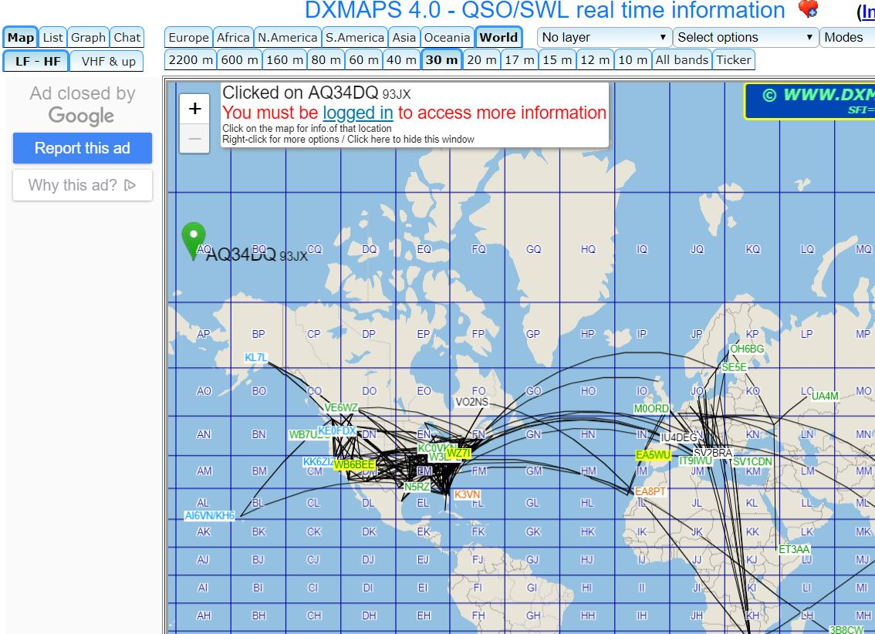
DX Maps Also Useful
Search Mode, Last 15mins, propagation model

Slide 21
DX : CLUSTER
Cluster : A DX Cluster is a means for Amateur (Ham) Radio operators to tell each other, in real time, about DX stations
Link to Logger
Set up from cluster utility – set Address and Ports
Can use more than one
VE7CC is a common
Highly Configurable
User/Spot base, distance, mode, country filters
Set Alarms and messaging
Select Rejects
Link to awards and alerts – LOTW users

Slide 22
Cluster Spotter Becomes Part Of Logger
CAT CONTROL
DXCC & Awards
CLUSTER Filter
The Cluster
Set Band, Mode and Origin Filters

Slide 23
How I Operate In My Shack : ICOM (linked To a Panadapter)

Slide 24
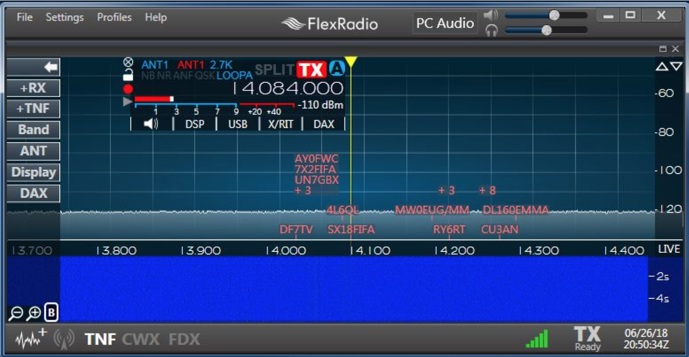
How I Operate in My Shack (Flex)

Slide 25
Some Concluding Remarks
This is just an introduction, but persistence pays
Tuning around still fun – even better now we have SDR and panoramic displays.
Now have fantastic intelligence and operating tools to catch the DX
Find out what works best for you
Consider joining one of the DX Spots Message Boards (CDXC)

